Slide 1

SQL Data Definition Commands: CREATE, ALTER, DROP, TRUNCATE, RENAME
Database Management System | SQL and Advanced Query Formulation
Course: Database Management System (DBMS) | Chapter: SQL and Advanced Query Formulation | Program: Bachelor of Engineering
DISCOVER · LEARN · EMPOWER
Notes:
Welcome students to this lecture on SQL Data Definition Language. We will explore the fundamental commands that allow us to build and modify database structures. As future engineers, mastering these commands is essential for designing robust data systems. Remember, every complex application starts with a well-defined schema.

Slide 2
Course Outcomes
SLIDE 2 / 14
Course Outcome
CO | BT LEVEL | DESCRIPTION
CO1 | BT2 | Explain database architecture, relational model concepts and formal query language foundations including relational algebra and relational calculus.
CO2 | BT3 | Apply relational algebra, relational calculus and SQL constructs to formulate correct and efficient database queries.
CO3 | BT4 | Analyze functional dependencies and design normalized relational schemas up to 5NF ensuring lossless join and dependency preservation.
CO4 | BT4 | Analyze transaction schedules and concurrency control mechanisms to determine serializability, recoverability and correctness.
CO5 | BT5 | Evaluate storage structures, indexing strategies and query optimization techniques for performance, scalability and reliability.
Chandigarh University
2 / 14
Notes:
This lecture directly supports our Course Outcomes. CO3 focuses on designing normalized schemas, which requires using CREATE and ALTER commands effectively. CO4 deals with transaction integrity, where understanding DROP and TRUNCATE is crucial for managing data states safely. These outcomes ensure you can build and maintain reliable database systems.

Slide 3
Learning Objectives
SLIDE 3 / 14
Learning Outcomes
1
Analyze the distinct roles of DDL commands in database lifecycle management.
2
Evaluate the structural differences between DROP and TRUNCATE operations.
3
Construct valid SQL statements for creating tables with primary keys.
4
Modify existing database schemas using ALTER commands for column changes.
5
Assess the risks associated with renaming objects in production environments.
Chandigarh University
3 / 14
Notes:
By the end of this session, you will be able to distinguish between the various DDL commands. We will analyze why TRUNCATE is faster than DELETE and how ALTER changes the physical structure. You will also learn to construct safe statements for renaming objects. These skills are critical for maintaining data integrity in real-world applications.

Slide 4
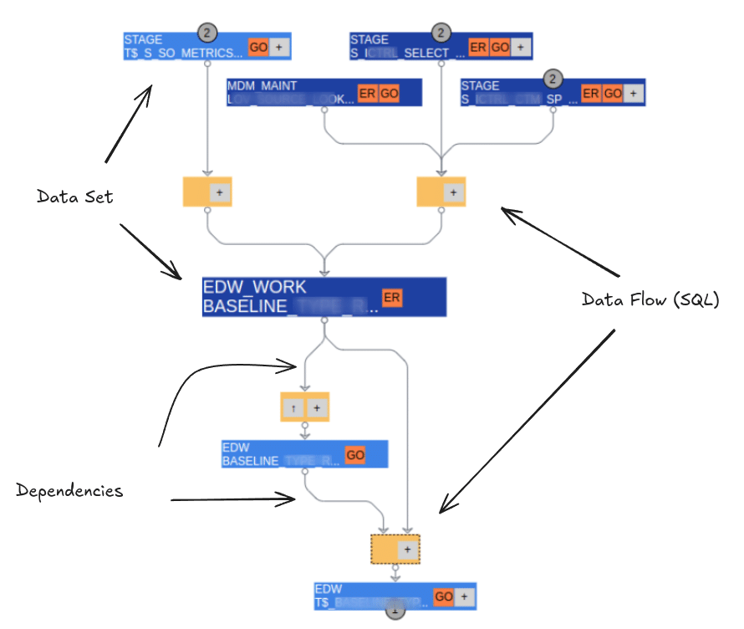
Lecture
SLIDE 4 / 14
Overview of SQL Data Definition Language
1
DDL commands define the logical structure of the database rather than data itself.
2
CREATE, ALTER, DROP, TRUNCATE, and RENAME are the core DDL operations.
3
These commands automatically commit changes in most standard SQL environments.
4
DDL operations affect the system catalog or data dictionary metadata.
5
Errors in DDL can lead to permanent loss of structural definitions.
6
Proper usage ensures the database schema aligns with application requirements.
SQL Visualisation Guide - Query Diagrams, Lineage & ERD
Chandigarh University
4 / 14
Notes:
Data Definition Language is the foundation of database design. Unlike DML which handles rows, DDL handles the containers themselves. When you issue a CREATE command, the database engine updates the system catalog immediately. This automatic commit behavior means you cannot roll back a DDL command in standard SQL without specific transaction controls.

Slide 5
CREATE Command
SLIDE 5 / 14
Building Database Objects
EXAMPLE
CREATE TABLE Students (ID INT PRIMARY KEY, Name VARCHAR(50));
• CREATE TABLE defines a new table with specific column names and data types.
• Syntax includes constraints like PRIMARY KEY, FOREIGN KEY, and NOT NULL.
• The command allocates storage space for the new table structure.
• Failure occurs if a table with the same name already exists.
• Use IF NOT EXISTS clause to prevent errors in automated scripts.
Chandigarh University
5 / 14
Notes:
The CREATE command is your primary tool for building new structures. Consider this example: creating a Students table requires defining the ID as an integer and the Name as a variable character string. If you try to create a table that already exists, the system throws an error unless you use the IF NOT EXISTS clause. This prevents script failures during deployment.

Slide 6
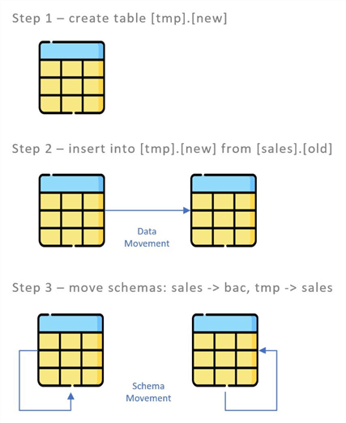
ALTER Command
SLIDE 6 / 14
Modifying Existing Structures
EXAMPLE
ALTER TABLE Students ADD COLUMN Email VARCHAR(100);
• ALTER TABLE modifies the definition of an existing table without deleting data.
• Common actions include adding columns, dropping columns, or changing data types.
• Changing data types may fail if existing data cannot be converted.
• Adding a column with a NOT NULL constraint requires default values.
• ALTER operations are generally slower than DML updates due to metadata changes.
Source: www.mssqltips.com
Chandigarh University
6 / 14
Notes:
The ALTER command allows you to evolve your schema as requirements change. For instance, adding an Email column is a common requirement. However, if you try to add a NOT NULL column without a default value, the database will reject the command because existing rows would violate the constraint. Always plan your schema changes carefully to avoid locking the table.

Slide 7

DROP Command
SLIDE 7 / 14
Removing Objects Completely
EXAMPLE
DROP TABLE Students; removes the entire Students table.
• DROP TABLE removes the table definition and all associated data permanently.
• The command deletes the table structure from the system catalog.
• Data cannot be recovered after a successful DROP operation.
• Foreign key constraints must be handled before dropping parent tables.
• Use DROP IF EXISTS to make scripts idempotent and safe.
Source: static.vecteezy.com
Chandigarh University
7 / 14
Notes:
DROP is the most destructive DDL command. It removes both the structure and the data. If you drop a table that is referenced by a foreign key in another table, the operation will fail unless you handle the constraints first. Always verify your dependencies before executing a DROP command in a production environment.

Slide 8
TRUNCATE Command
SLIDE 8 / 14
Fast Data Removal
EXAMPLE
TRUNCATE TABLE Students; clears data instantly without logging rows.
• TRUNCATE TABLE removes all rows from a table but keeps the structure.
• It is a DDL operation that resets the high-water mark of the table.
• TRUNCATE is significantly faster than DELETE because it does not log individual rows.
• Identity columns are reset to their seed value after truncation.
• Cannot be used if the table is referenced by a foreign key constraint.
Chandigarh University
8 / 14
Notes:
TRUNCATE is often confused with DELETE, but they are fundamentally different. DELETE is a DML command that logs every row deletion, making it slower. TRUNCATE is a DDL command that deallocates data pages, making it instant. For example, clearing a table with a million rows takes seconds with TRUNCATE but minutes with DELETE. However, you cannot use TRUNCATE if other tables reference it.

Slide 9
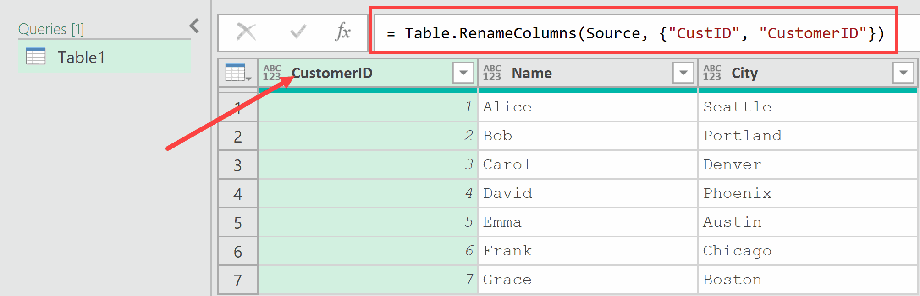
RENAME Command
SLIDE 9 / 14
Changing Object Names
SYNTAX VARIES BY DBMS
RENAME TABLE old_name TO new_name.
EXAMPLE
RENAME TABLE Students TO Enrolled_Students;
• RENAME TABLE changes the name of an existing database object.
• Updates all internal references to the object in the system catalog.
• Does not affect the data stored within the table.
• Requires appropriate permissions to modify object metadata.
Source: trumpexcel.com
Chandigarh University
9 / 14
Notes:
The RENAME command is useful for refactoring or correcting naming conventions. When you rename a table, the database updates the system catalog so that all subsequent queries use the new name. The data remains untouched. However, you must ensure that no external applications are hard-coding the old table name, or they will fail to connect.

Slide 10
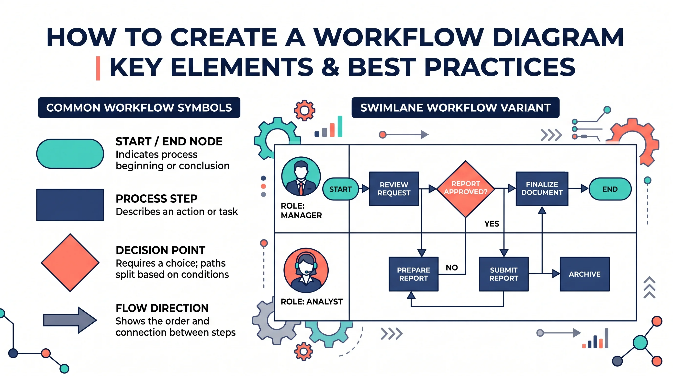
Worked Example
SLIDE 10 / 14
Schema Evolution Scenario
GOVERNING EQUATION
Step 2: UPDATE Students SET Major = 'CS' WHERE ID = 101
SCENARIO
A university adds a 'Major' column to the Students table.
STEP 1
ALTER TABLE Students ADD COLUMN Major VARCHAR(50);
STEP 3
DROP TABLE Old_Students_Backup; (cleanup after migration).
STEP 4
RENAME TABLE Students TO Current_Students;
RESULT
The schema evolves while preserving historical data integrity.
Source: conceptviz.app
Chandigarh University
10 / 14
Notes:
Let's walk through a real scenario. First, we alter the table to add a Major column. Then we update existing records to assign a default major. After migration, we drop the old backup table to save space. Finally, we rename the table to reflect its current status. This sequence demonstrates how DDL commands work together to manage database evolution.

Slide 11
Lecture
SLIDE 11 / 14
Common Pitfalls in DDL Operations
1
Accidental DROP commands can lead to irreversible data loss.
2
Using TRUNCATE on tables with foreign keys causes constraint violations.
3
ALTERing a column to a smaller data type truncates existing data.
4
Renaming a table without updating application code breaks functionality.
5
Forgetting to commit DDL changes in environments requiring explicit commits.
6
Executing DDL in a transaction without proper rollback capabilities.
Chandigarh University
11 / 14
Notes:
DDL operations carry significant risks. A common pitfall is truncating a table that is referenced by another table, which causes a foreign key violation. Another issue is altering a column to a smaller size, which silently truncates data. Always test DDL scripts in a development environment before running them in production to avoid these costly mistakes.

Slide 12
Lecture
SLIDE 12 / 14
Impact on Transaction and Concurrency
1
DDL commands typically cause an implicit commit of the current transaction.
2
They often acquire exclusive locks on the table being modified.
3
Concurrent DML operations may be blocked during DDL execution.
4
TRUNCATE resets transaction logs differently than DELETE in some systems.
5
DDL operations affect the visibility of data to other concurrent sessions.
6
Proper locking strategies are essential for maintaining data consistency.
Chandigarh University
12 / 14
Notes:
Understanding concurrency is vital for DDL. When you run a DROP command, the database often locks the table exclusively, blocking other users from accessing it. This can cause performance bottlenecks in high-traffic systems. Furthermore, DDL commands usually commit any open transactions automatically, which means you cannot roll back a DDL change within a larger transaction block.

Slide 13
Lecture
SLIDE 13 / 14
Key Takeaways
1
DDL commands define and modify the database structure, not the data.
2
CREATE builds new objects, while ALTER modifies existing ones safely.
3
DROP removes objects permanently, whereas TRUNCATE clears data quickly.
4
RENAME changes object identifiers without affecting stored data content.
5
Always verify constraints and dependencies before executing destructive DDL commands.
Chandigarh University
13 / 14
Notes:
To summarize, DDL commands are the tools you use to build and maintain your database skeleton. Remember that DROP is permanent, while TRUNCATE is a fast reset. Always be cautious with ALTER and RENAME to avoid breaking dependencies. These commands are powerful, so use them with precision and care.

Slide 14
Lecture
SLIDE 14 / 14
References
1
Fundamentals of Database Systems — Ramez Elmasri & Shamkant B. Navathe
2
Database System Concepts — Silberschatz, Korth & Sudarshan
3
Database Management Systems — Raghu Ramakrishnan & Johannes Gehrke
4
Oracle/MySQL Documentation — Oracle
Chandigarh University
14 / 14
Notes:
For further reading, I recommend the standard texts by Elmasri and Navathe, as well as Silberschatz. These books provide deep insights into database theory and practical SQL implementation. The Oracle documentation is also an excellent resource for specific syntax details. Please review these materials to reinforce your understanding of DDL commands.

